Slide 1


Slide 2
Aggregation
Summarizing Data In SQL

Slide 3
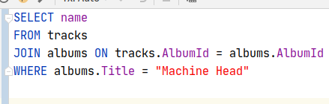
Last Lecture
In the last lecture we learned about JOINS, which allowed you to correlate one table with another via a condition (typically a foreign key)
In this lecture, we are going to discuss how to “roll data up” into useful summary data, using the GROUP BY clause
Notes:
Can be found online… but I can’t link to it

Slide 4
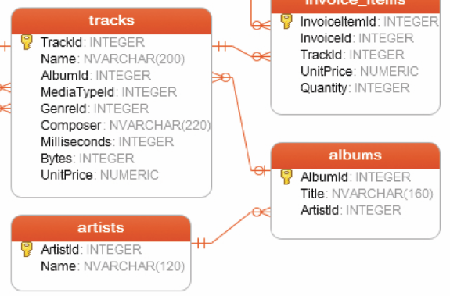
Tracks & Albums
We will be focusing on the following three tables
Tracks
Albums
Artists
Notes:
Can be found online… but I can’t link to it

Slide 5
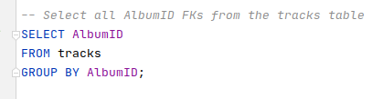
GROUP BY
The general form of the GROUP BY clause is: SELECT columns FROM table GROUP BY columns
Notes:
Can be found online… but I can’t link to it

Slide 6
GROUP BY
This query will select all data in the tracks table and, for each AlbumID, group the results into a single resulting row
Not a very interesting grouping, but this does return all distinct AlbumIDs in the tracks table
Notes:
Can be found online… but I can’t link to it

Slide 7

DISTINCT
Speaking of distinct album IDs, there is also a DISTINCT operator that can be used
If you were really just after distinct AlbumIDs, this would be clearer
Notes:
Can be found online… but I can’t link to it

Slide 8
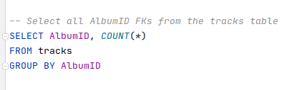
GROUP BY
So, what is GROUP BY for then?
The typical use case for GROUP BY is for rolling data up with Aggregate Functions
Notes:
Can be found online… but I can’t link to it

Slide 9
GROUP BY
Here is an example that uses the COUNT() aggregate function
This query will aggregate all rows rows with the same AlbumID, and include a count of the number of rows
Notes:
Can be found online… but I can’t link to it

Slide 10
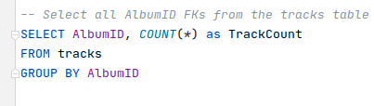
GROUP BY
Often you will want to give a nice name to the aggregated column, by using an alias
This makes it easier to work with in the resulting data
Notes:
Can be found online… but I can’t link to it

Slide 11
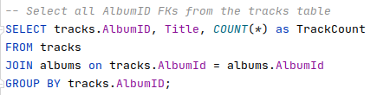
GROUP BY
Group By can be combined with Joins to give even better results
Note that we had to fully qualify tracks.AlbumID because this column is in both the tracks and albums table
This makes AlbumID by itself ambiguous
Notes:
Can be found online… but I can’t link to it

Slide 12
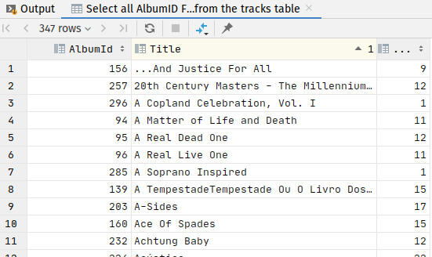
GROUP BY
This new query now gives us something really cool: the count of the number of tracks on each album!
This is a legitimate report-tier query that a business might ask for
Notes:
Can be found online… but I can’t link to it

Slide 13
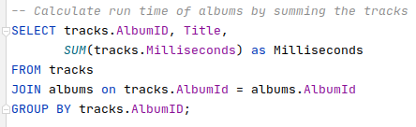
GROUP BY
Other Aggregation Functions
AVG - average
MAX - maximum value
MIN - minimum value
SUM - summed value
What is the total runtime of albums?
Notes:
Can be found online… but I can’t link to it

Slide 14
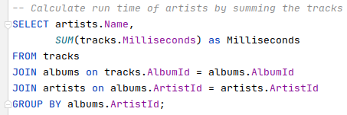
GROUP BY
What if we wanted to extend this out to find out the total runtime of music by artists?
Add another JOIN and update the GROUP BY clause
Notes:
Can be found online… but I can’t link to it

Slide 15
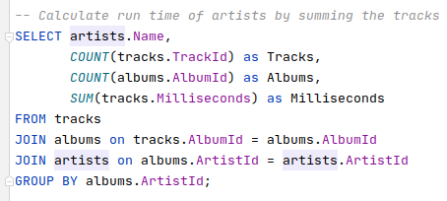
GROUP BY
What if we want to see the number of tracks and albums as well?
Attempt 1, add counts of TrackID and AlbumID
Notes:
Can be found online… but I can’t link to it

Slide 16
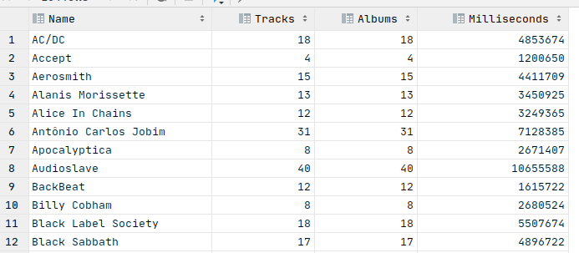
GROUP BY
What if we want to see the number of tracks and albums as well?
Attempt 1, add counts of TrackID and AlbumID
Oops...
Notes:
Can be found online… but I can’t link to it

Slide 17
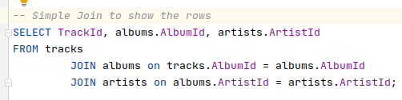
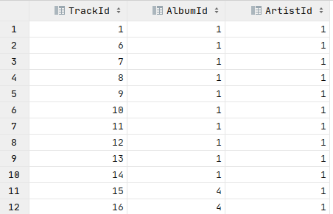
GROUP BY
The problem here is that when we GROUP BY, we get a row for each unique track/album/artist combination
There are just as many AlbumIds as TrackIds
Notes:
Can be found online… but I can’t link to it

Slide 18
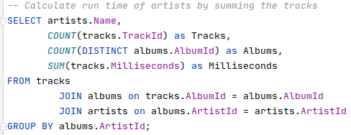
GROUP BY
DISTINCT to the rescue!
Attempt 2
Notes:
Can be found online… but I can’t link to it

Slide 19
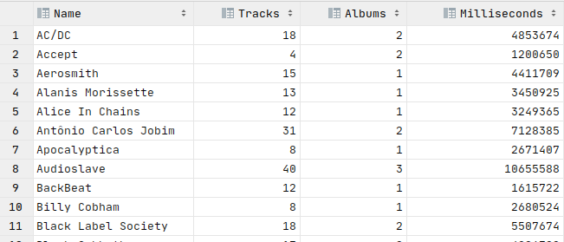
GROUP BY
DISTINCT to the rescue!
Attempt 2
Yeah kids, now we are cookin’ with gasoline
Notes:
Can be found online… but I can’t link to it

Slide 20
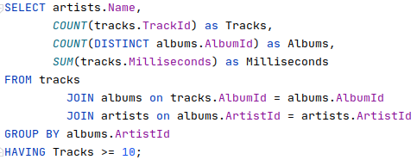
GROUP BY
What if we wanted this information for all artists having more than 10 tracks?
We can use the HAVING clause
Notes:
Can be found online… but I can’t link to it

Slide 21
GROUP BY
The HAVING clause is similar to the WHERE clause, but it applies to the aggregated data
All predicates in the HAVING clause should work only with aggregated columns
SQLite doesn’t enforce this
Not sure why
Notes:
Can be found online… but I can’t link to it

Slide 22
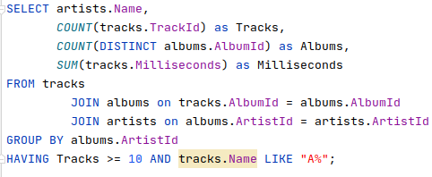
GROUP BY
Show me all artists who have tracks that start with an A, and the count of tracks and albums that these tracks are on, and the total runtime of those tracks
First attempt… nope.
Notes:
Can be found online… but I can’t link to it

Slide 23
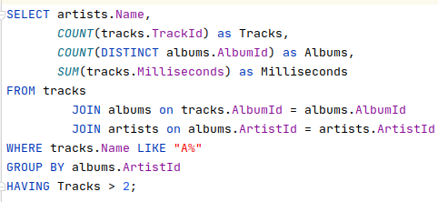
GROUP BY
You might be tempted to put this in the HAVING clause and, unfortunately, SQLite allows this
Not quite sure what it means
But SQLite warns you: this should be in the WHERE clause instead
Notes:
Can be found online… but I can’t link to it

Slide 24
GROUP BY
Note that the WHERE clause is applied first, before aggregation
Then the data is aggregated
Then the HAVING clause is applied
Notes:
Can be found online… but I can’t link to it

Slide 25
GROUP BY
Let’s go back to this query
What if we wanted to include the average runtime of tracks in this query?
Notes:
Can be found online… but I can’t link to it

Slide 26
Aggregation Summary
OK, so, we looked at the GROUP BY functionality in SQL, for creating aggregate queries
We saw how you can join across one or more tables to generate more useful queries
We discussed how you can use the HAVING clause to filter your aggregated data
And we talked about how the WHERE clause can still be used to filter out data before aggregation occurs
Pretty cool stuff!

